Slide 1
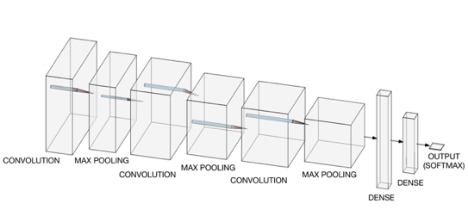
Convolutional neural networks for image recognition in Keras and TensorFlow
Umberto Michelucci Founder and AI Chief Scientist - TOELT llc umberto.michelucci@toelt.ai

Slide 2
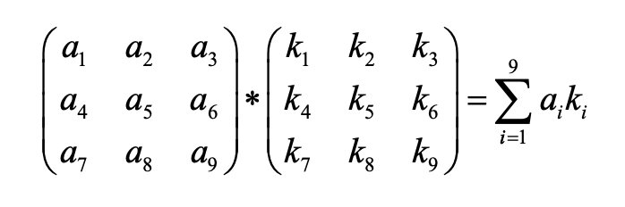
Convolution between two matrices (equal size)

Slide 3
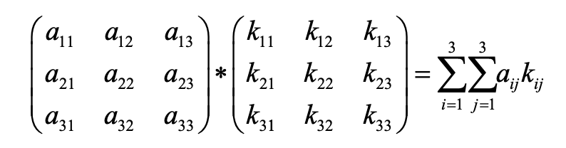
Convolution between two matrices (equal size)

Slide 4
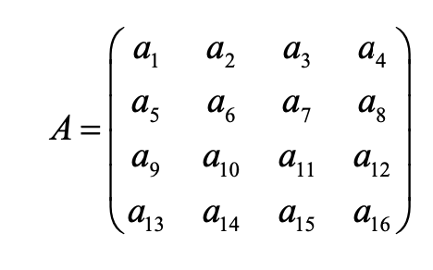
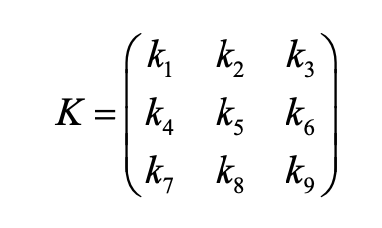
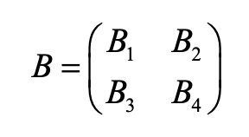
Convolution
Kernel or Filter
Convolution symbol

Slide 5
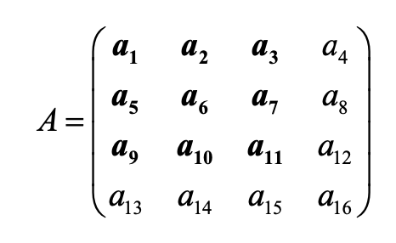
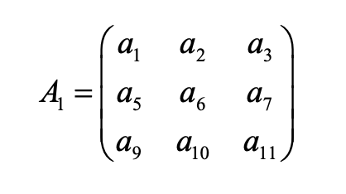
How convolution works

Slide 6
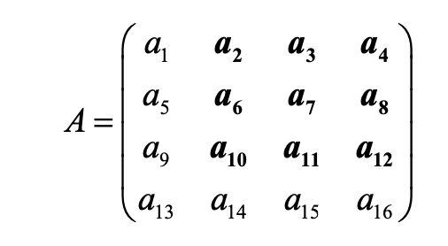
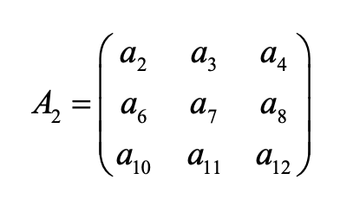
How convolution works

Slide 7
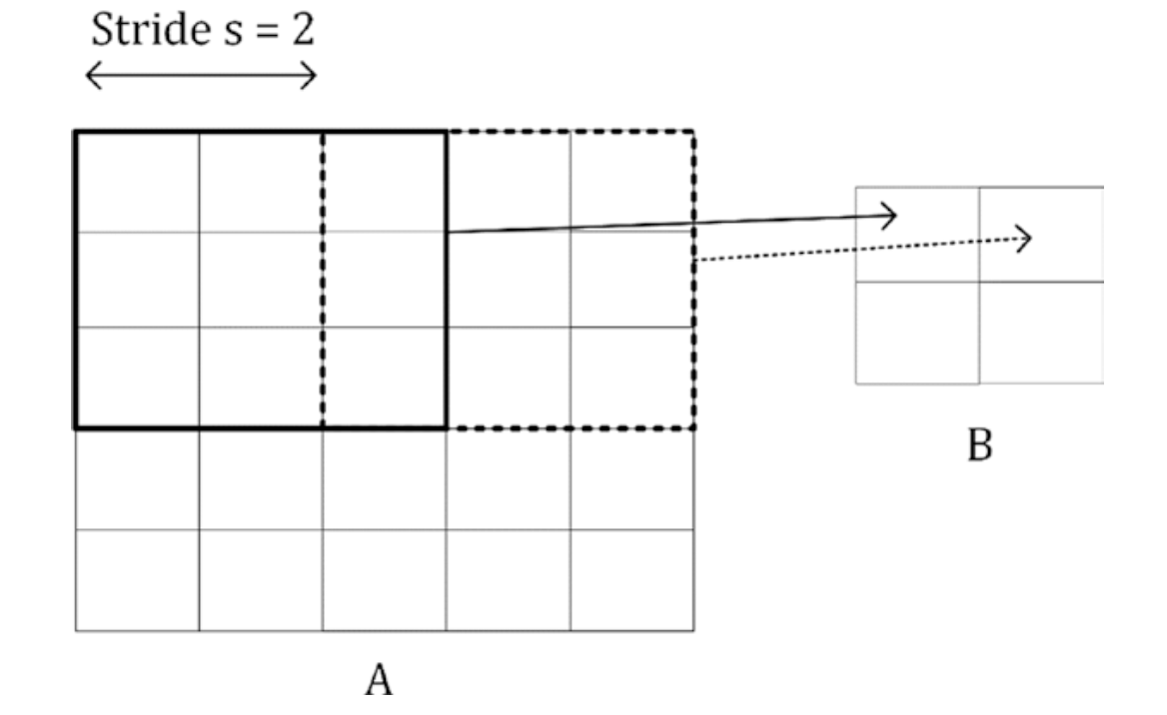
Stride

Slide 8
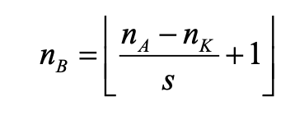
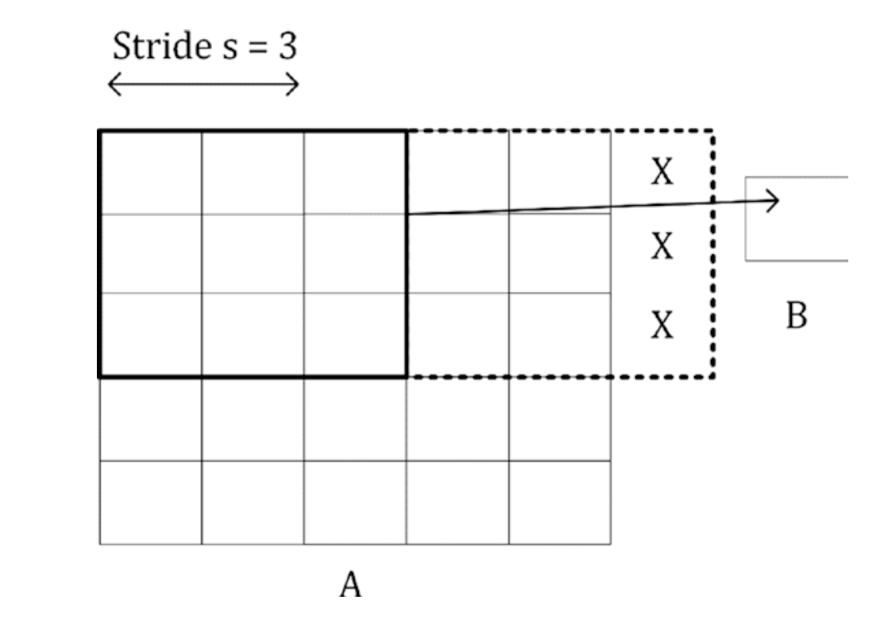
Size of output of convolution
Stride

Slide 9
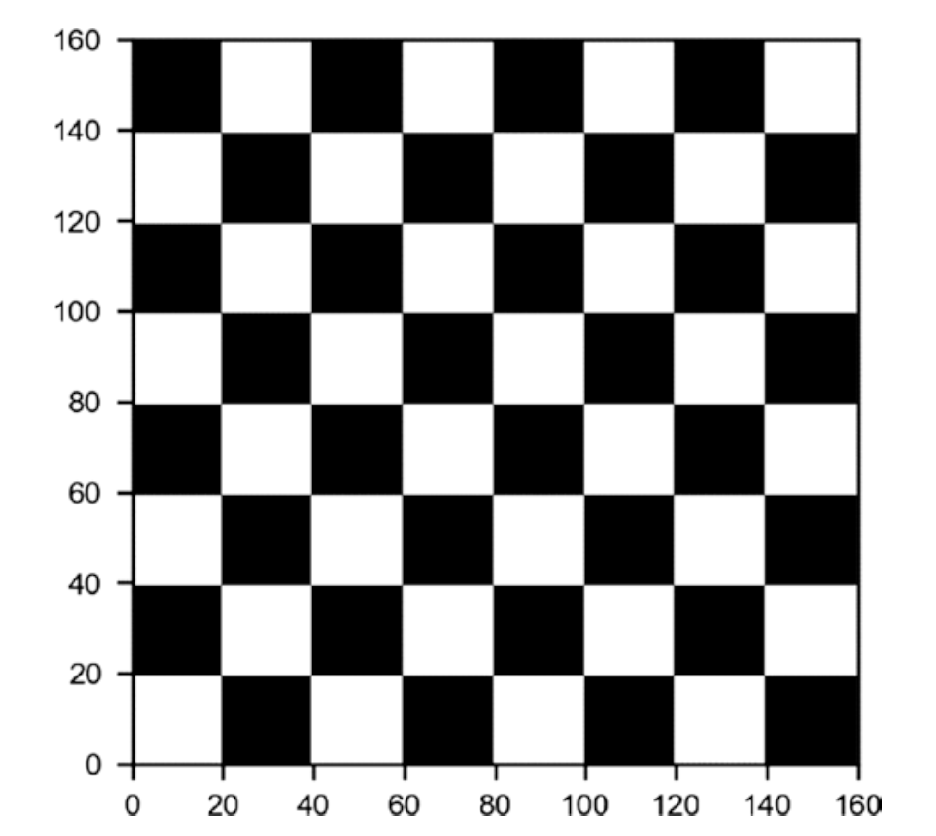
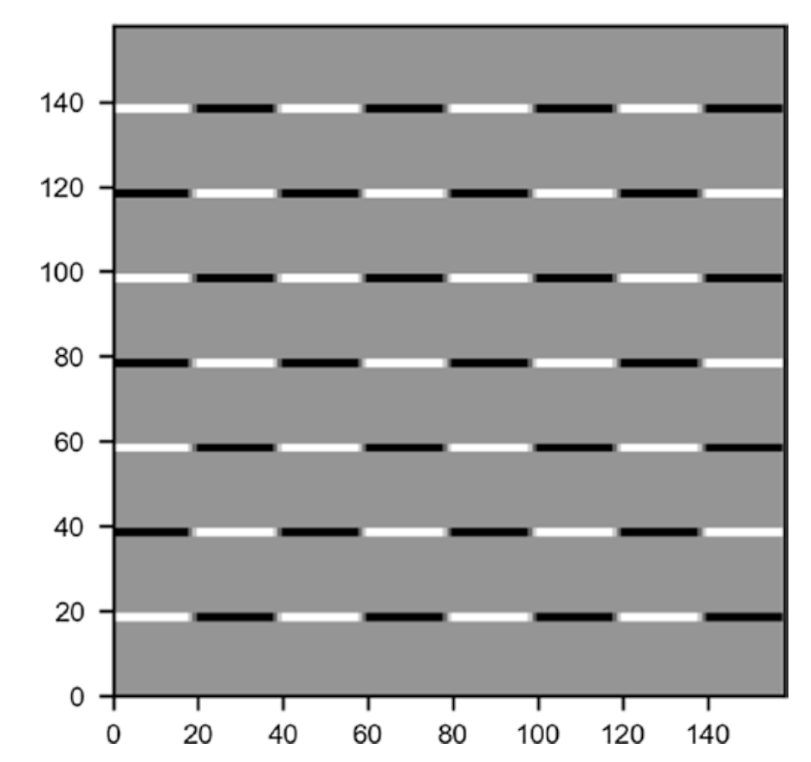
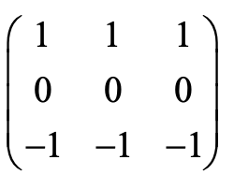
Examples of convolutions
=
*

Slide 10
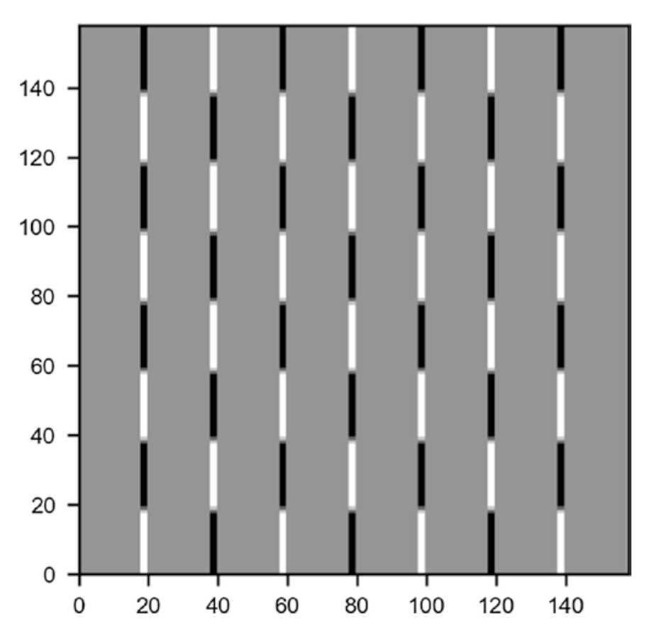
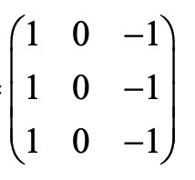
Examples of convolutions
=
*

Slide 11
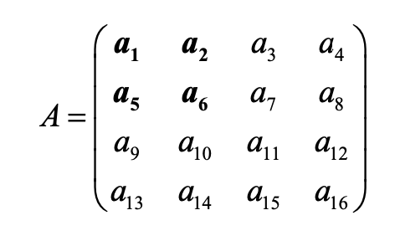


Pooling (max and average)
We select a pooling size (for example 2x2)
Output of max-pooling
Output of average-pooling

Slide 12
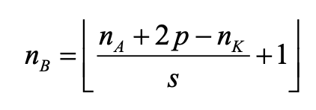
Padding
Adding elements to the output of convolutions or pooling to get back the original size
Dimension of output with stride (s) and padding (p)

Slide 13
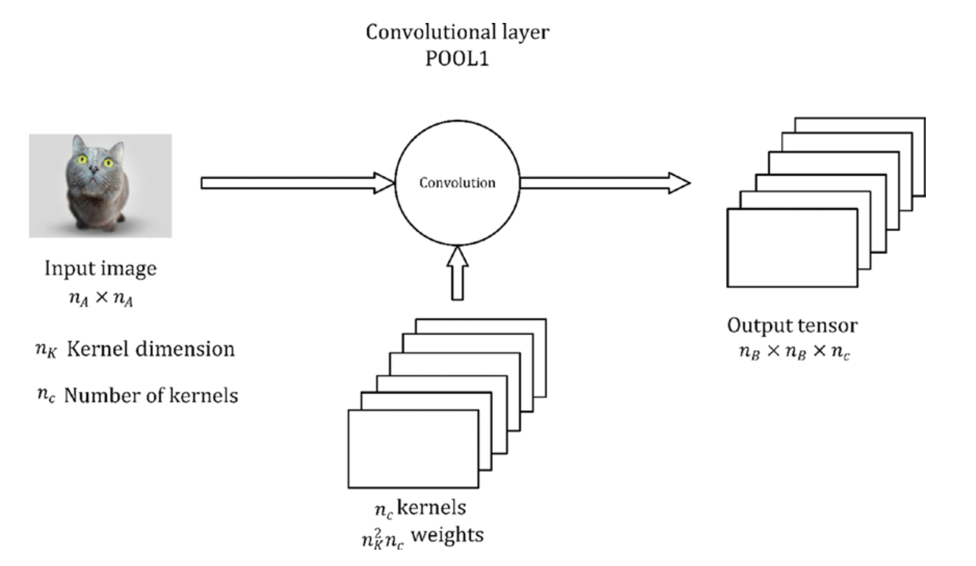
Building blocks of a CNN - Convolution

Slide 14
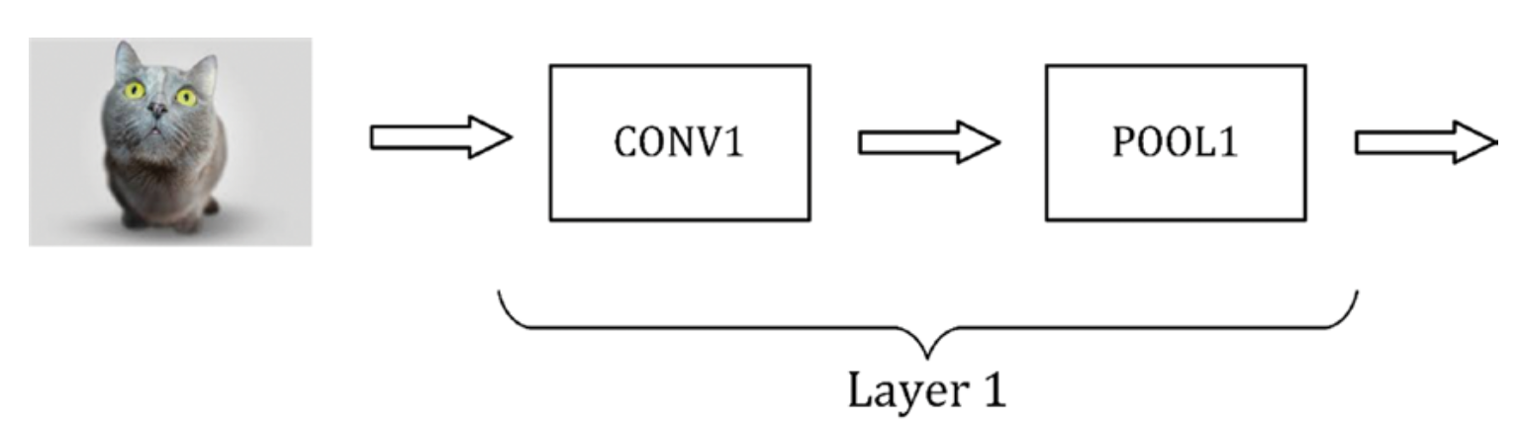
Building blocks of a CNN - stacking everything together

Slide 15
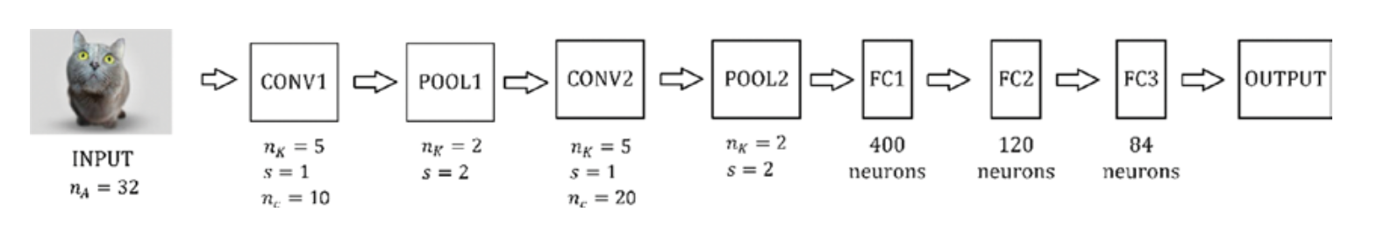
Example of a CNN
Representation of a CNN similar to the famous LeNet-5 network

Slide 16
Hands-on
Session (CNN)
https://github.com/michelucci/oreilly-london-ai/blob/master/day1/Beginner%20friendly%20networks/First_example_of_a_CNN_with_the_MNIST_dataset.ipynb
https://github.com/michelucci/oreilly-london-ai/blob/master/day1/Beginner%20friendly%20networks/First_Example_of_a_CNN_(CIFAR10).ipynb

